Slide 1
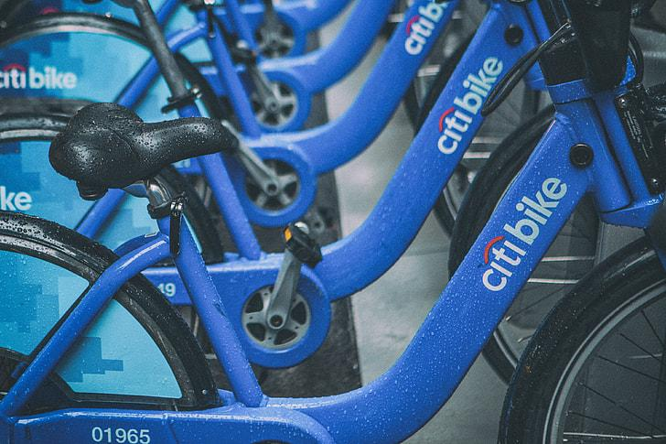
NYC CITIBIKE
(Tableau Mock-up) DASHBOARD
Outline of Project
Data: Citibike User & Station Data
Analysis & Machine Learning: Jupyter Notebook and Random Forest
Tableau: Dashboard
Google Slides: Presentation
Weekday Interactive Chart (With Filter)
Weekend Interactive Chart (With Filter)
Image of Initial Analysis
Map with Markers for Citibike Locations
(Hover for Location Specific Date)
Tools Utilized In Project to Create Final Dashboard:
Python Pandas, Pyspark, PostgreSQL, AWS, Scikit-learn, Random Forest, Neural Networks, Tensorflow, Tableau
Links to Specific Tableau Visualization Tabs

